Slide 1
Configure an EC2 Alert for Reboot and Shutdown

Slide 2
What is AWS CloudWatch?
Amazon CloudWatch monitors your Amazon Web Services (AWS) resources and the applications you run on AWS in real time. You can use CloudWatch to collect and track metrics, which are variables you can measure for your resources and applications.
For example, you can monitor the CPU usage and disk reads and writes of your Amazon EC2 instances and then use this data to determine whether you should launch additional instances to handle increased load. You can also use this data to stop under-used instances to save money.
With CloudWatch, you gain system-wide visibility into resource utilization, application performance, and operational health.

Slide 3
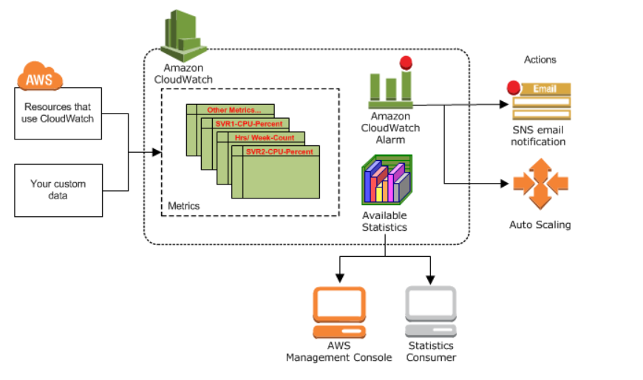
How Amazon CloudWatch Works?
Amazon CloudWatch is basically a metrics repository. An AWS service—such as Amazon EC2—puts metrics into the repository, and you retrieve statistics based on those metrics.
If you put your own custom metrics into the repository, you can retrieve statistics on these metrics as well.

Slide 4
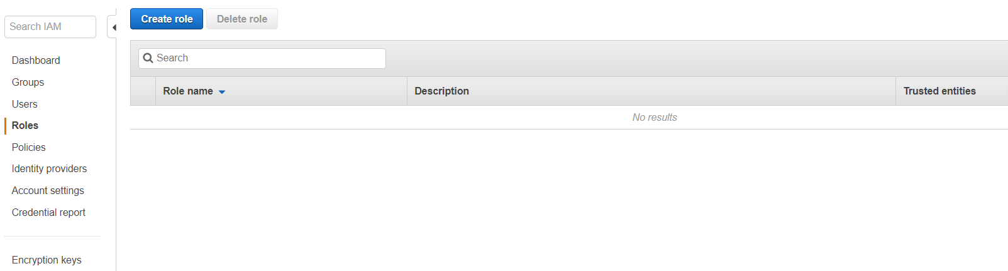
Using Amazon CloudWatch alarm actions, you can create alarms that automatically stop, terminate, reboot, or recover your EC2 instances.
To set up a CloudWatch alarm action that can reboot, stop, or terminate an instance, you must use a service-linked IAM role, AWSserviceRoleForCloudWatchEvents The AWSServiceRoleForCloudWatchEvents IAM role enables AWS to perform alarm actions on your behalf.
Go to IAM Console and Click on Create Role

Slide 5
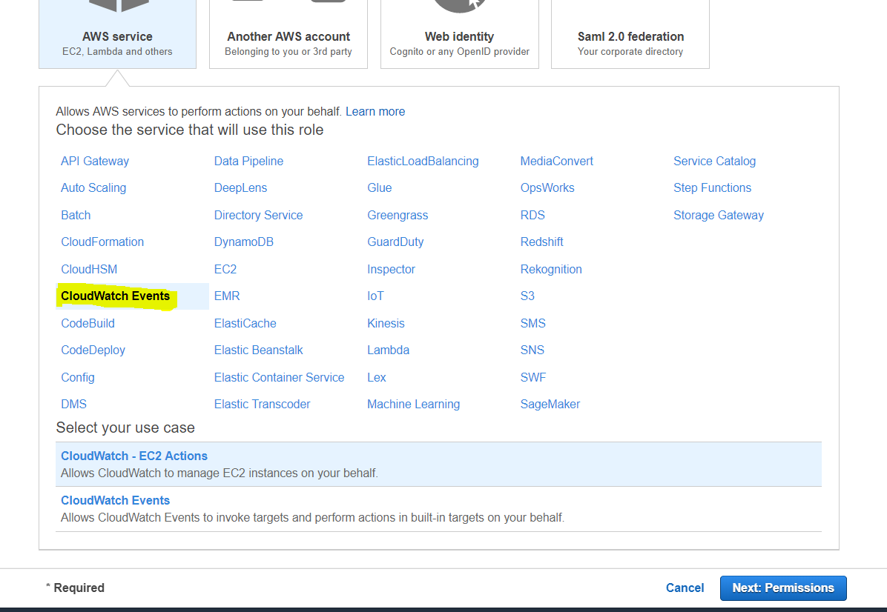
Click on CloudWatch Events in AWS Service tab and Select your use case as CloudWatch-EC2 Actions.

Slide 6
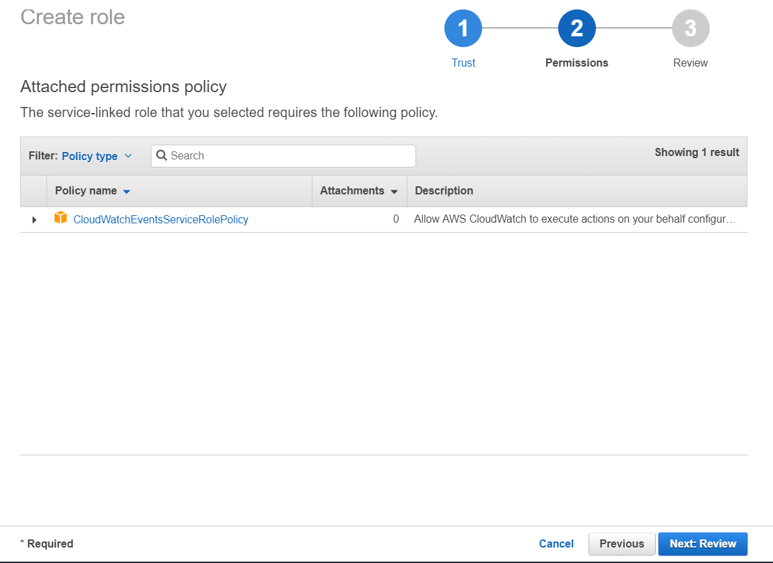
In Attach Policy page, Select the CloudWatchEventsServiceRolePolicy
Click on Next Review button

Slide 7
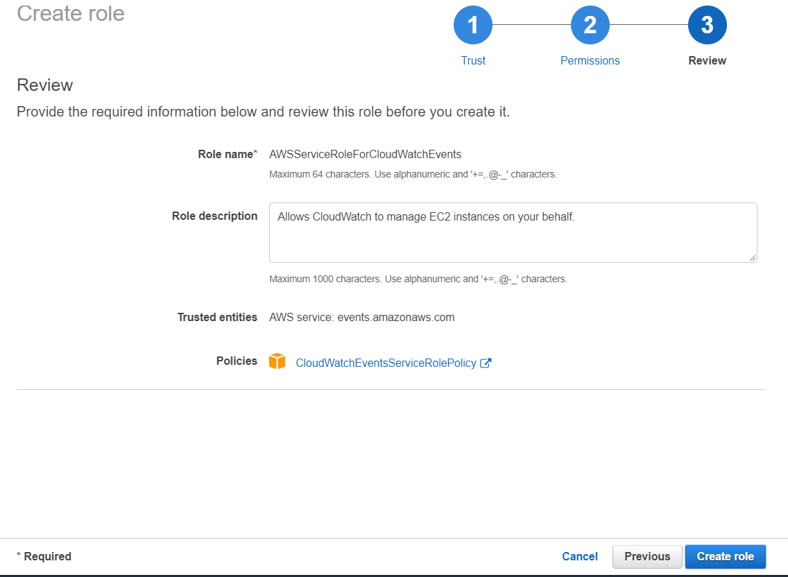
Review the Role and Click on Create Role.

Slide 8
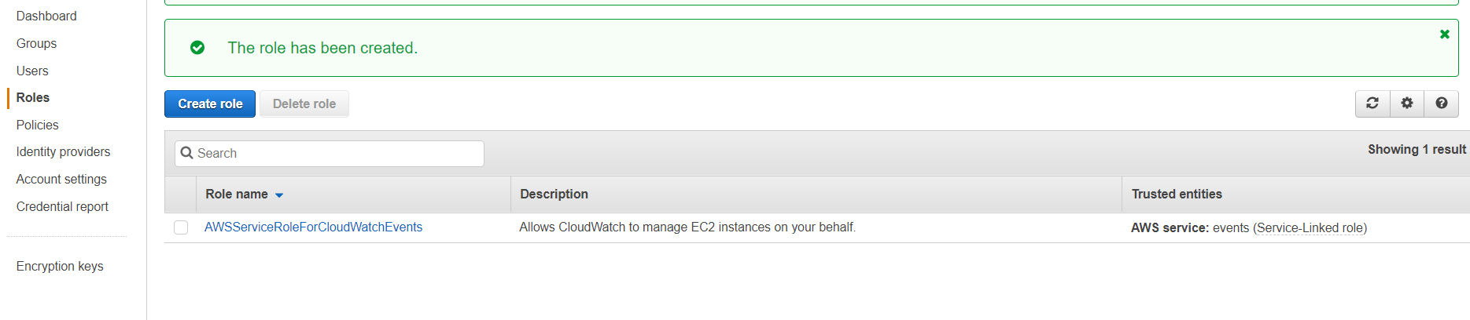
You can see the Created Role in the Roles tab in IAM Console

Slide 9
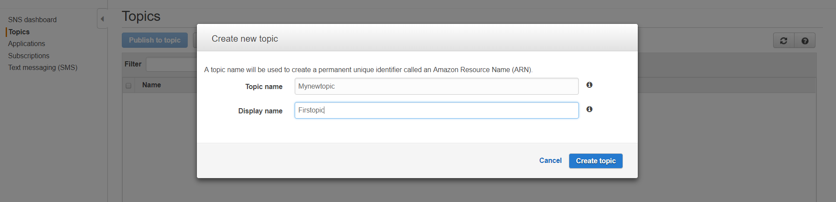
Amazon CloudWatch uses Amazon SNS to send email. First, create and subscribe to an SNS topic. When you create a CloudWatch alarm, you can add this SNS topic to send an email notification when the alarm changes state.
First, create a topic, then subscribe to it. You can optionally publish a test message to the topic.
Click on Create topic in SNS Console, Give the Topic Name and Display Name.

Slide 10
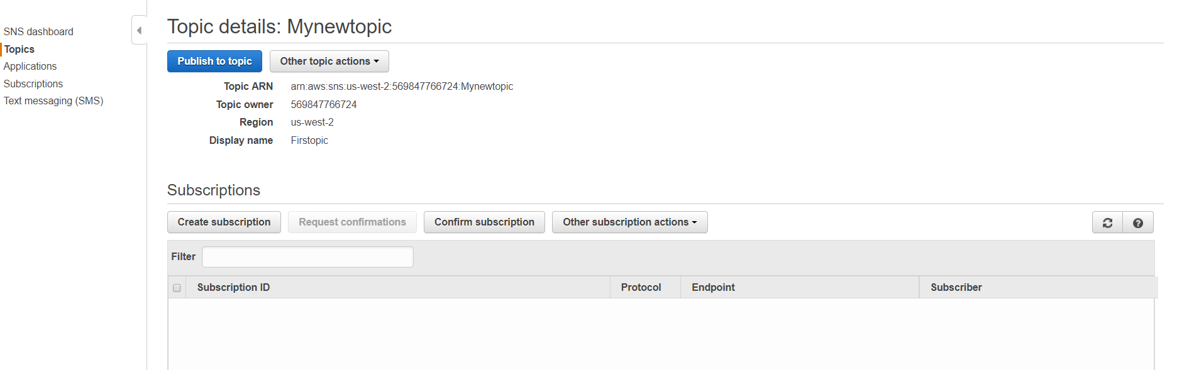
You can view the topic details page by clicking on the Topic.

Slide 11
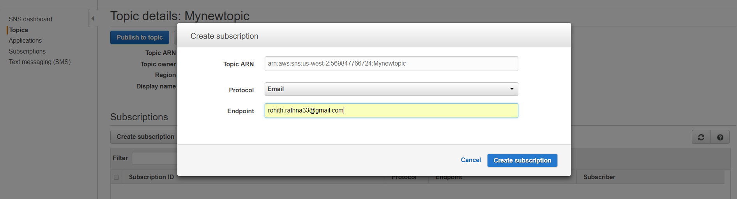
Click on Create Subscription and give the Protocol and Endpoint you prefer.
Here, I am giving the protocol as Email and Endpoint is mailID.

Slide 12
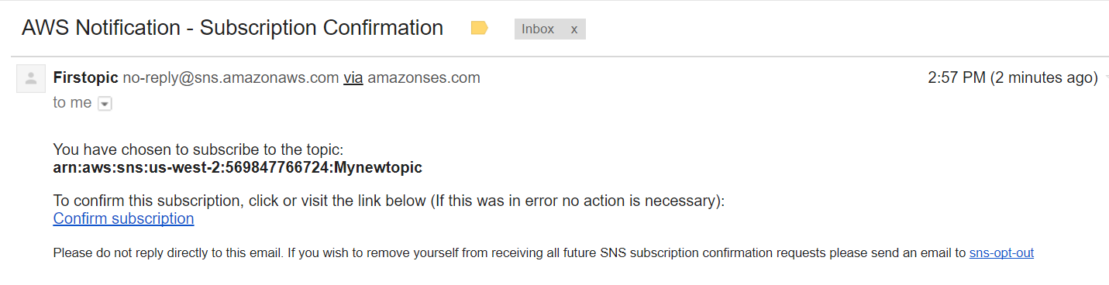
Once you click on Create subscription, you will get an Confirmation Email to your Endpoint.
Click on Confirm Subscription.

Slide 13
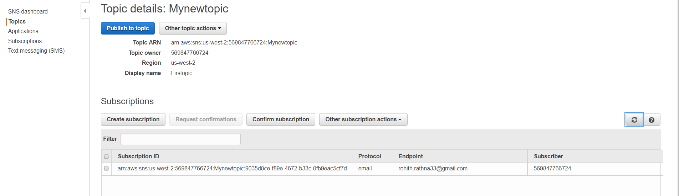
Once you Subscribe, You will see the Subscriber ID in ARN format and AWS Account number in Subscriber tab.

Slide 14
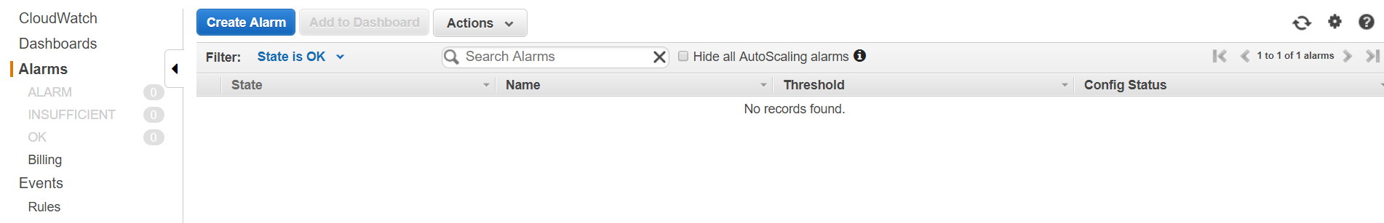
Go to CloudWatch Console and Click on Create Alarm.

Slide 15
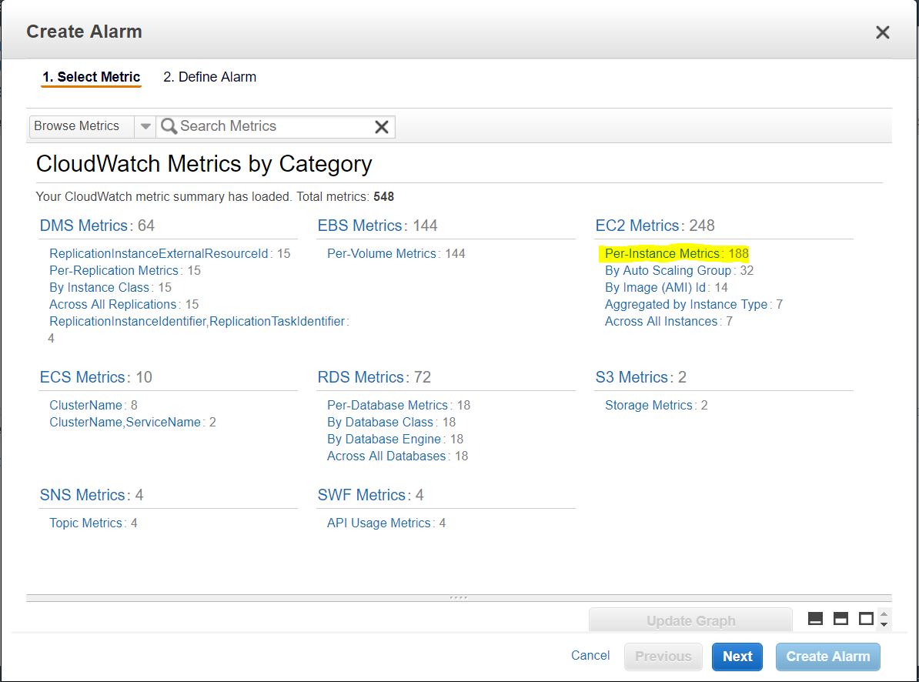
In Select Metric tab, Select the EC2 Metrics and Click on Per Instance Merics.

Slide 16
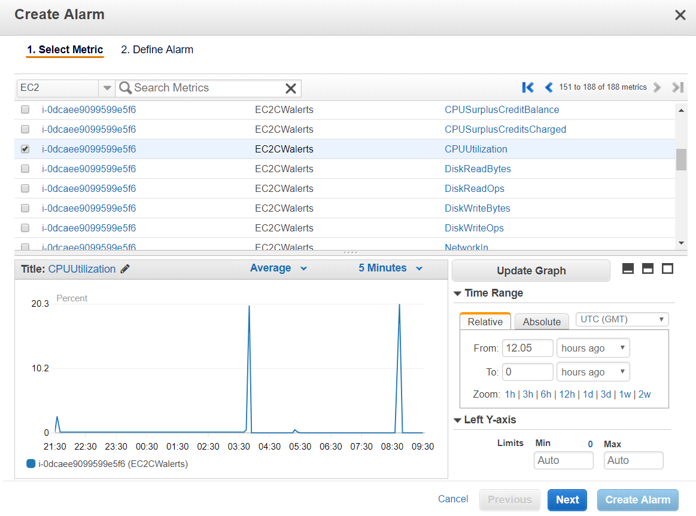
Click on the Instance ID for which you want to configure an alert as per the Metric(Here I am Selecting CPU Utilization),
Click on Next

Slide 17
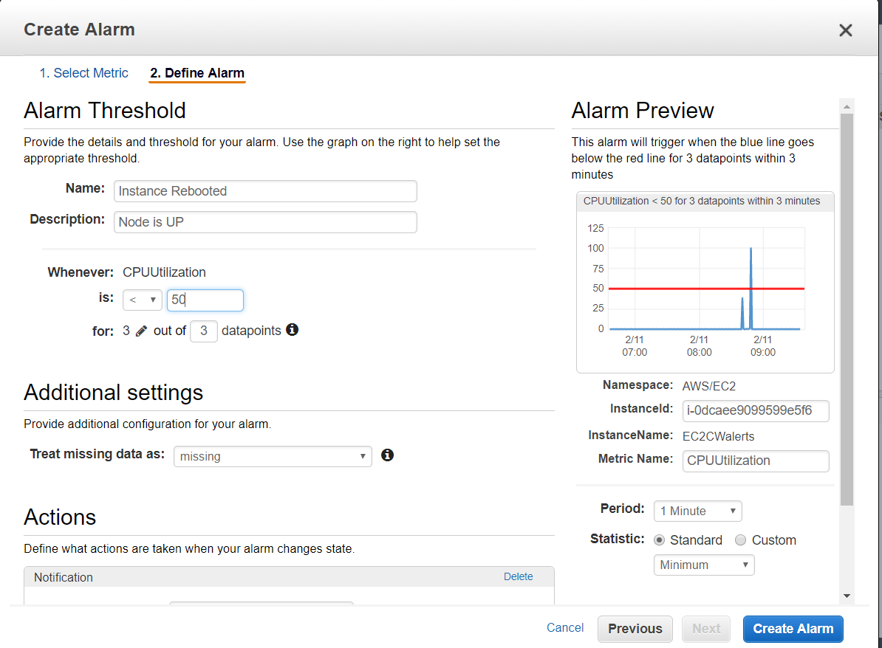
In Define Alarm tab, Give the Name and Description as you need.
Select the Threshold, Here for example I am choosing it as < 50 for 3 datapoints.
Keep the Period for 1 Minute(Metric per 1 minute Frequency is available only when you enable detailed monitoring) and Statistic as Minimum.

Slide 18
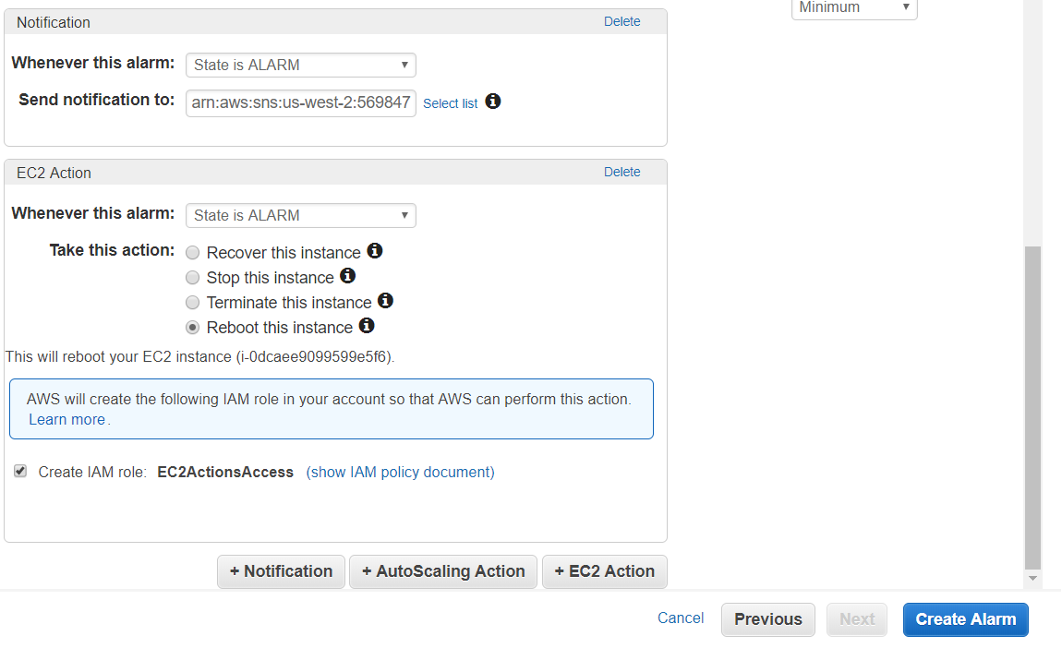
In Actions tab click on Notification and Select State is Alarm in Whenever this alarm tab.
In Send Notification tab, Give your Topic ARN.
In EC2 Action tab, Select State is Alarm in Whenever this alarm tab.
Select the Reboot this Instance Action and Check the Create IAM Role and Click on Create Alarm.

Slide 19
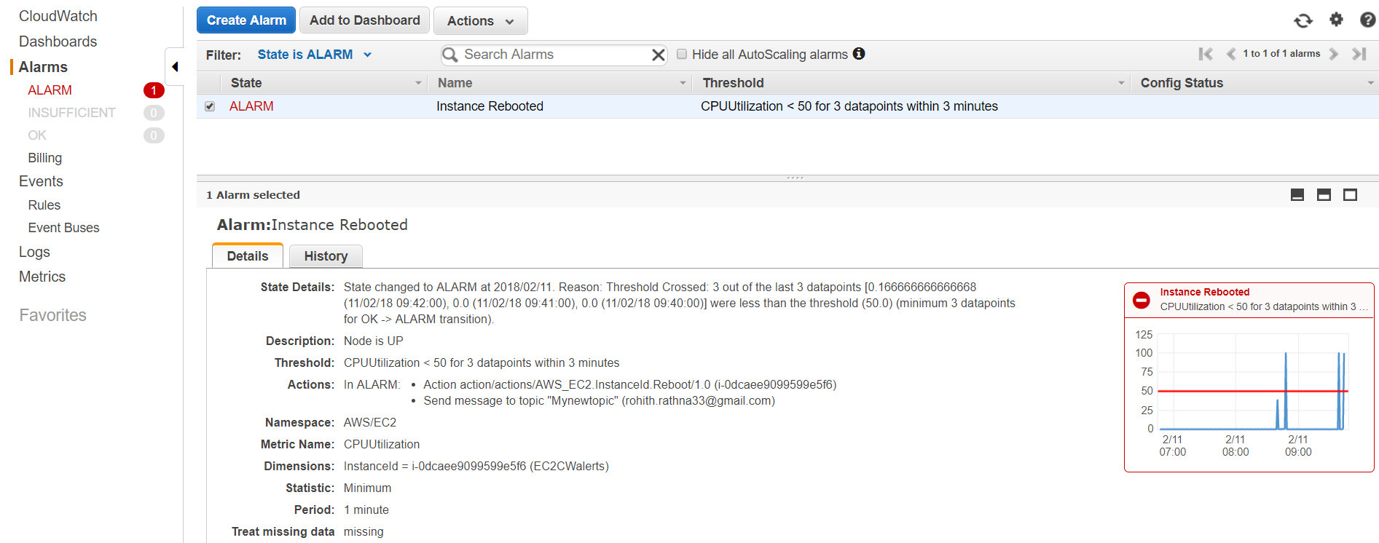
Once the Threshold crosses 3 out of 3 datapoints, Instance Reboots automatically.
We can see the State Change from OK to Alarm(Means Instance Rebooted) in below page.

Slide 20
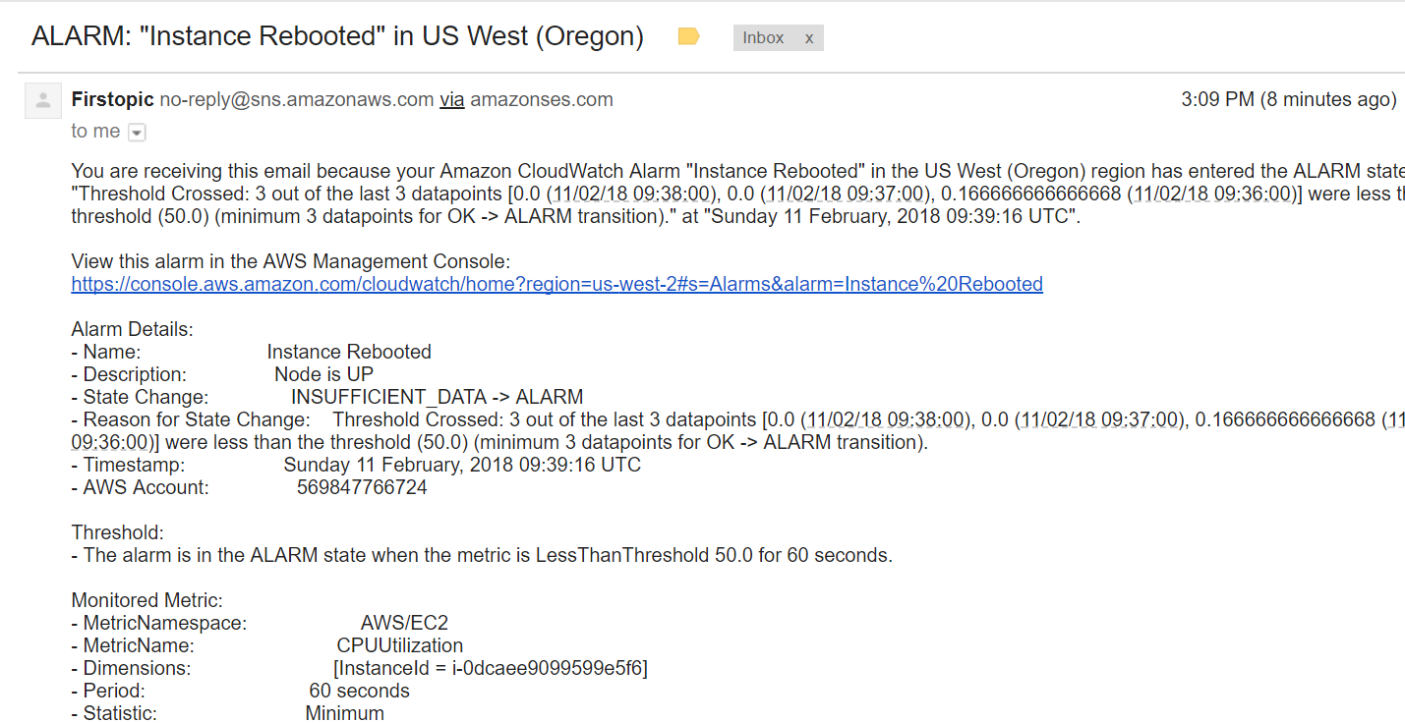
As we defined in the Notification tab earlier, You will get notify to your Endpoint.
Here, I got a Mail saying Instance Rebooted with all the required details.

Slide 21
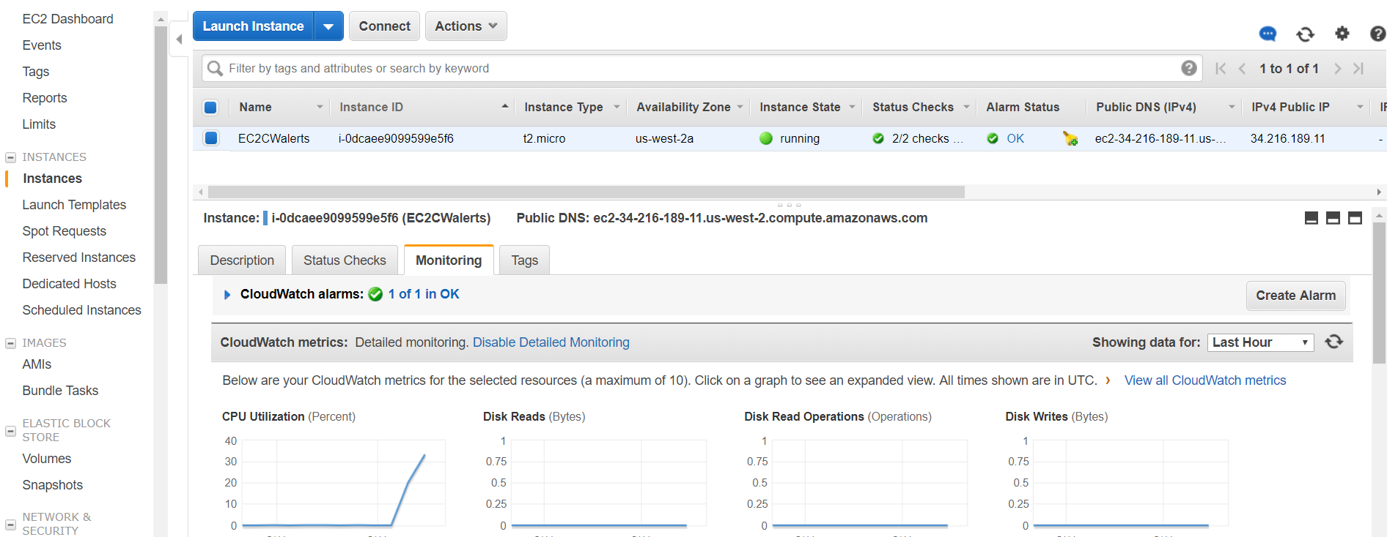
You can see the Instance got Rebooted and the State of the Alarm changed to OK.

Slide 22
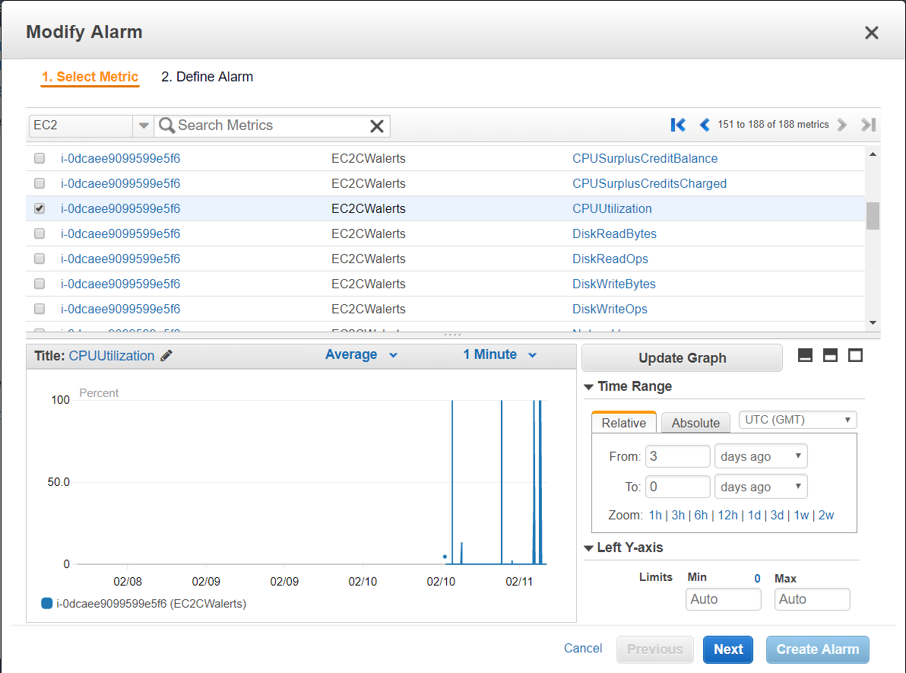
You can use the stop or terminate actions to help you save money when you no longer need an instance to be running.(Here, Shutdown behaviour defined as Stop)
Select the Instance ID of your Running instance in Select Metric tab.
Select a CPUUtilization Metric for your dimension

Slide 23
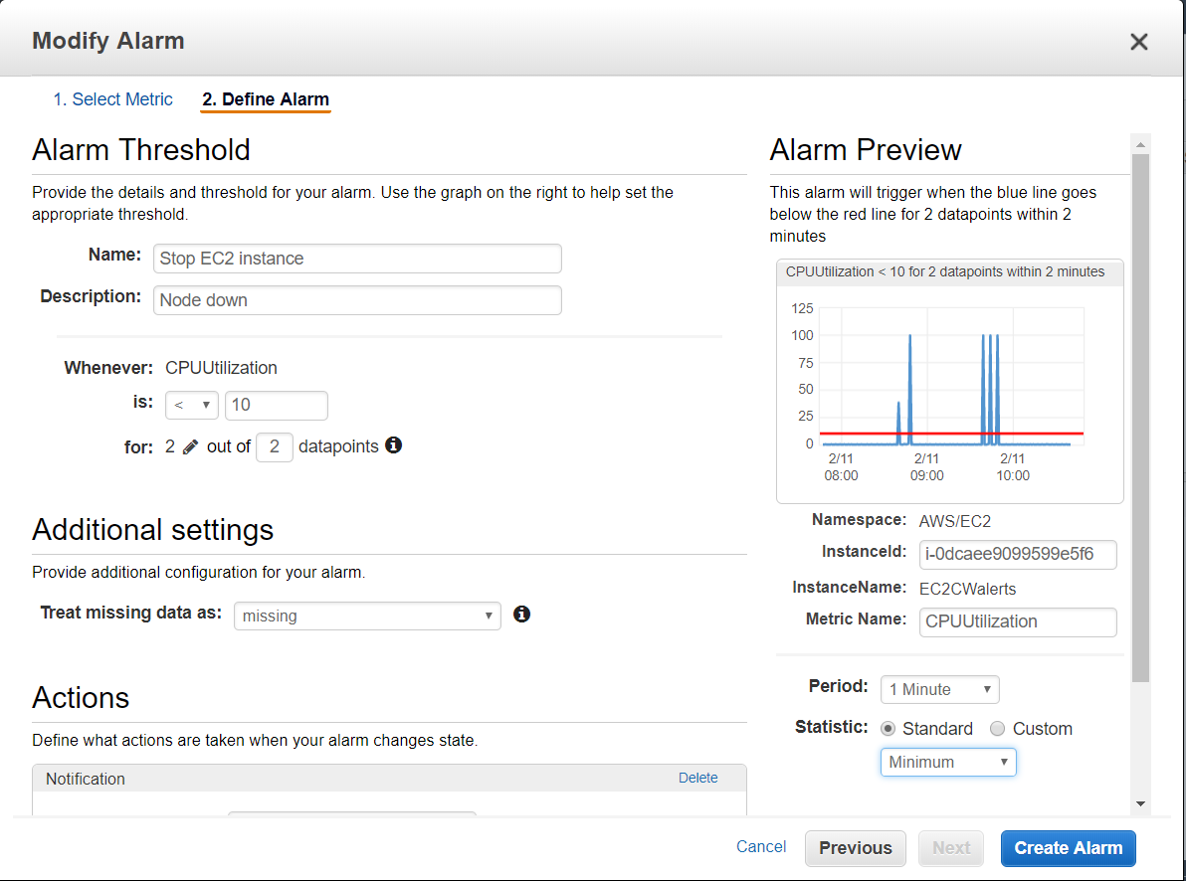
In Define Alarm tab, Give the Name and Description as you need.
Select the Threshold, Here for example I am choosing it as < 10 for 2 datapoints.
Keep the Period for 1 Minute and Statistic as Minimum.

Slide 24
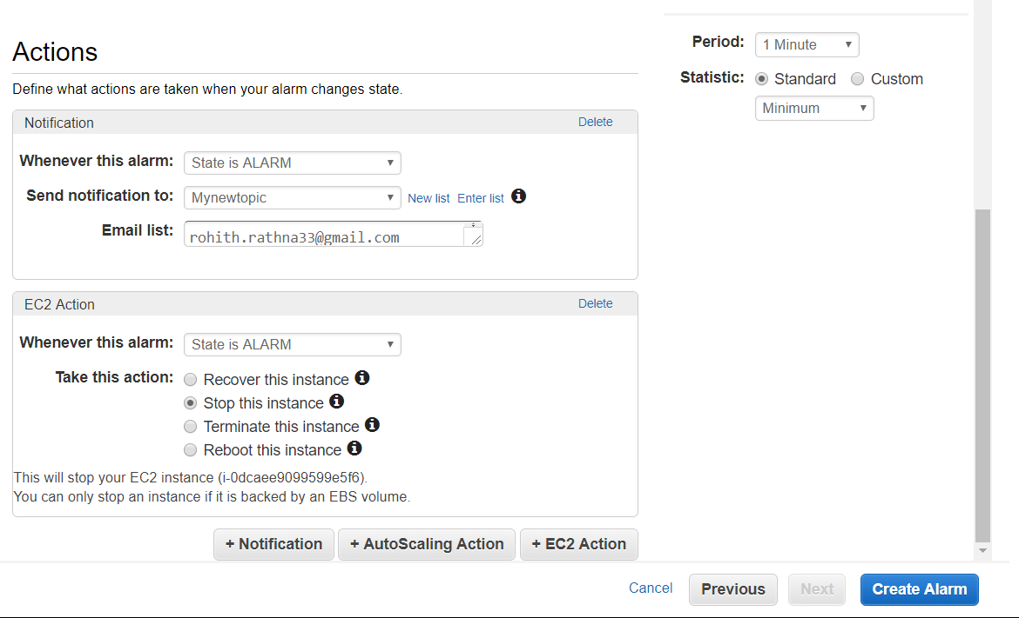
In Actions tab click on Notification and Select State is Alarm in Whenever this alarm tab.
In Send Notification tab, Give your Topic ARN.
In EC2 Action tab, Select State is Alarm in Whenever this alarm tab.
Select the Stop this Instance Action and Check the Create IAM Role and Click on Create Alarm

Slide 25
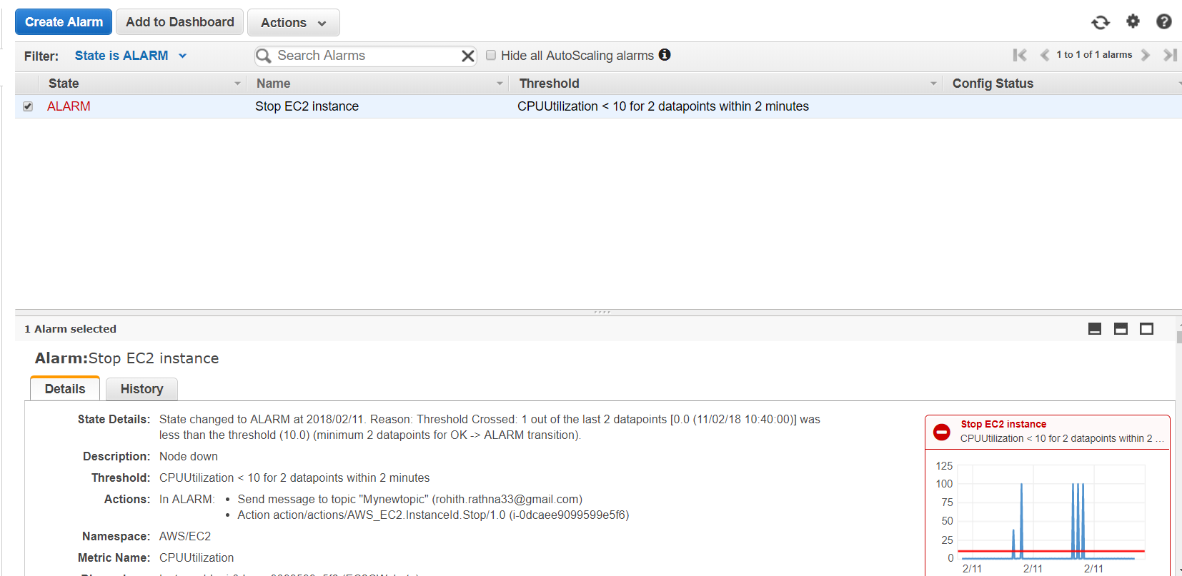
Once the Threshold crosses 2 out of 2 datapoints, Instance Stops automatically.
We can see the State is Alarm (Means Instance Stopped) in below page.

Slide 26
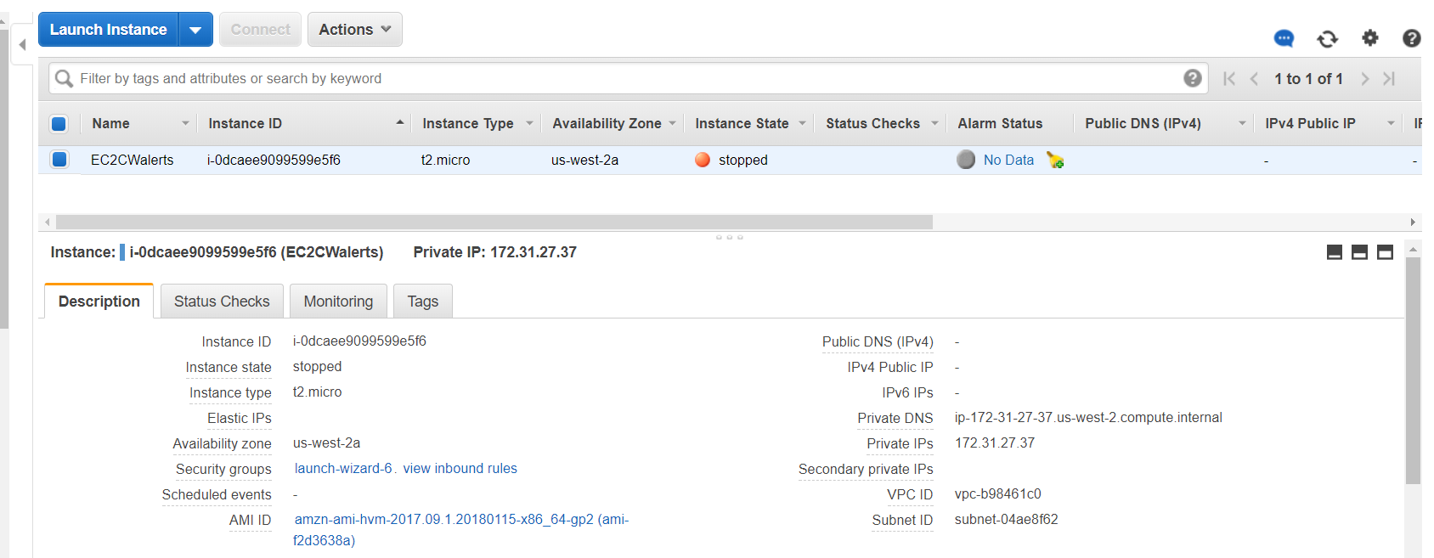
You can see the Instance stopped after it Crossed the Threshold.

Slide 27
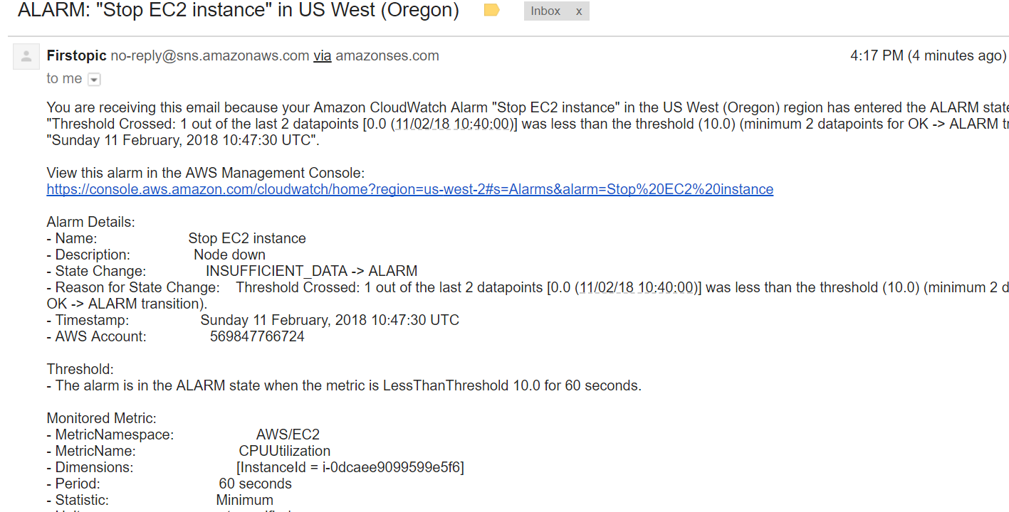
As we defined in the Notification tab earlier, You will get notify to your Endpoint.
Here, I got a Mail saying Instance Rebooted with all the required details.

Slide 28
THANK YOU

